Slide 1

DriverPass System Analysis
Taylor Stapus
Notes:
[No speaker notes required for this slide.]

Slide 2

System Requirements
Nonfunctional
Performance
Platform Constraints
Accuracy and Precision
Adaptability
Security
Functional
Create and Maintain Account
Package Selection
Schedule Lessons and Test
Download Reports
Payment Process
DMV Updates
Notes:
The DriverPass Program will have two different types of requirements, Functional and Non-Functional. Nonfunctional requirements specify criteria that can be used to judge the operation of a system, rather than the specific behavior. While functional requirement are the methods that are supposed to be performed though the system.
For DriverPass the Non-functional will include performance, septically a web-based system that is accessible on multiple platforms, consistent speeds and can update and grow with demand. Also, with the program running on a web-based system we would need to use an operating system with the capability of running major browsers, such as chrome, edge, Firefox etc. and a database to hold all of the information inputted. This system needs to be accurate by notifying admins of potential security threats and we could lessen those risk by implementing a strict login method that locks an account after 5 tries. With DriverPass growing rapidly we need to make sure that the system can accommodate new users while also catering to current user who might need to update or change their own information. Lastly security is a must to ensure all confidential information stays that way. Employees and customers will have limited access to the system while the owner and admin have the ability to maintain, update and delete accounts if necessary. All changes made will send the user a confirmation email to make sure the changes are authentic.
Now going into the Functional Requirements. The first step of this system will be to create and log into the account. We need to create web pages that accommodate the different services that we are looking to supply such as test lesson packages and a payment section. Special cases with limited access will be functions such as downloading report specifically for the owner and the ability for admin to update and delete accounts. Since we are a driving business, we need to make sure that we stay up to date with the current DMV regulations. We will be making sure those rules are current and available to all users who might need them.

Slide 3
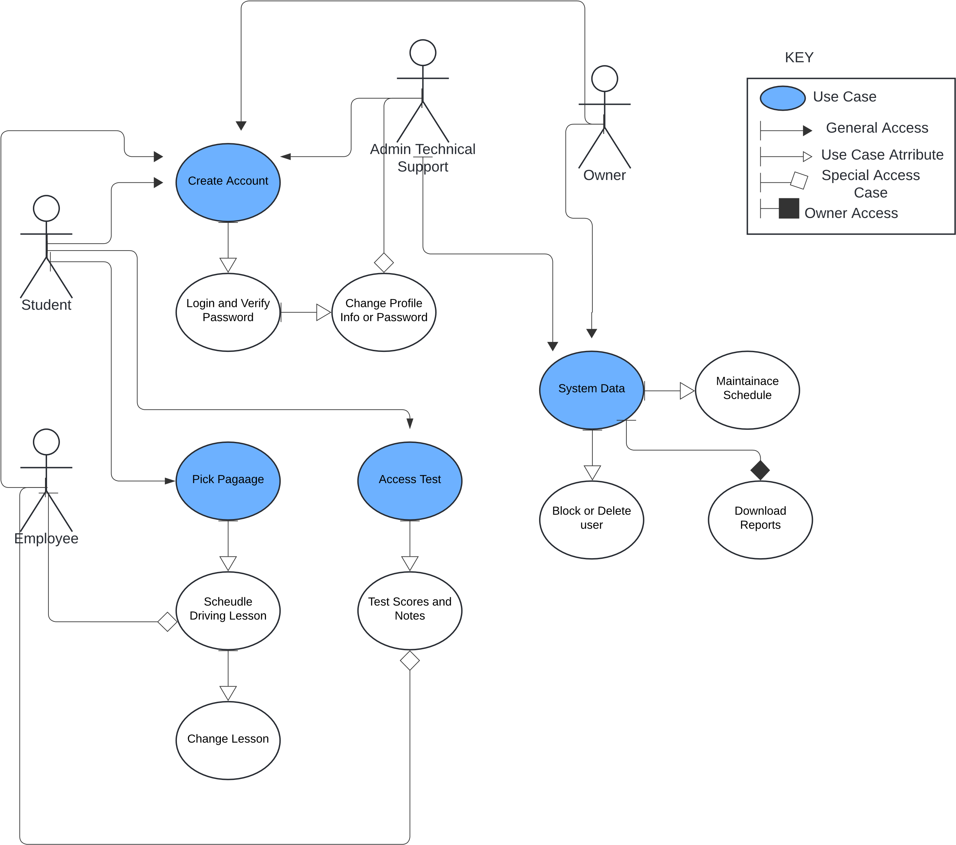
Use Case Diagram
Notes:
Above you will see a Use Case Diagram on how users are supposed to interact with the DriverPass program. There are four stick figures that represent the type of users the program can have; the Owner, the Customer, the Driver and Admin/IT.
Now going from there, you will notice arrow lines coming from the users. These indicate which functions of the program that the user will have access to. The Owner will have access to everything, but they have special access, show with a black diamond line that they have admission to the Data System that allows downloads of report. While IT/Admin also can utilize the Data System section, they will be limited to only using the maintenance schedule and block or delete users. Customers will be able to use the Create Account use case as well as the Test and Pick Package. Drivers will be swoop into the Test and Pick Package section, but they will only have the ability to schedule lesson and update test scores/driver notes. This can be seen with the while diamond special case. Every user will be able to create and maintain their own account but the white arrow coming from the Admin/IT show that they will be able to provide that assistance to users other than themselves if need be.

Slide 4
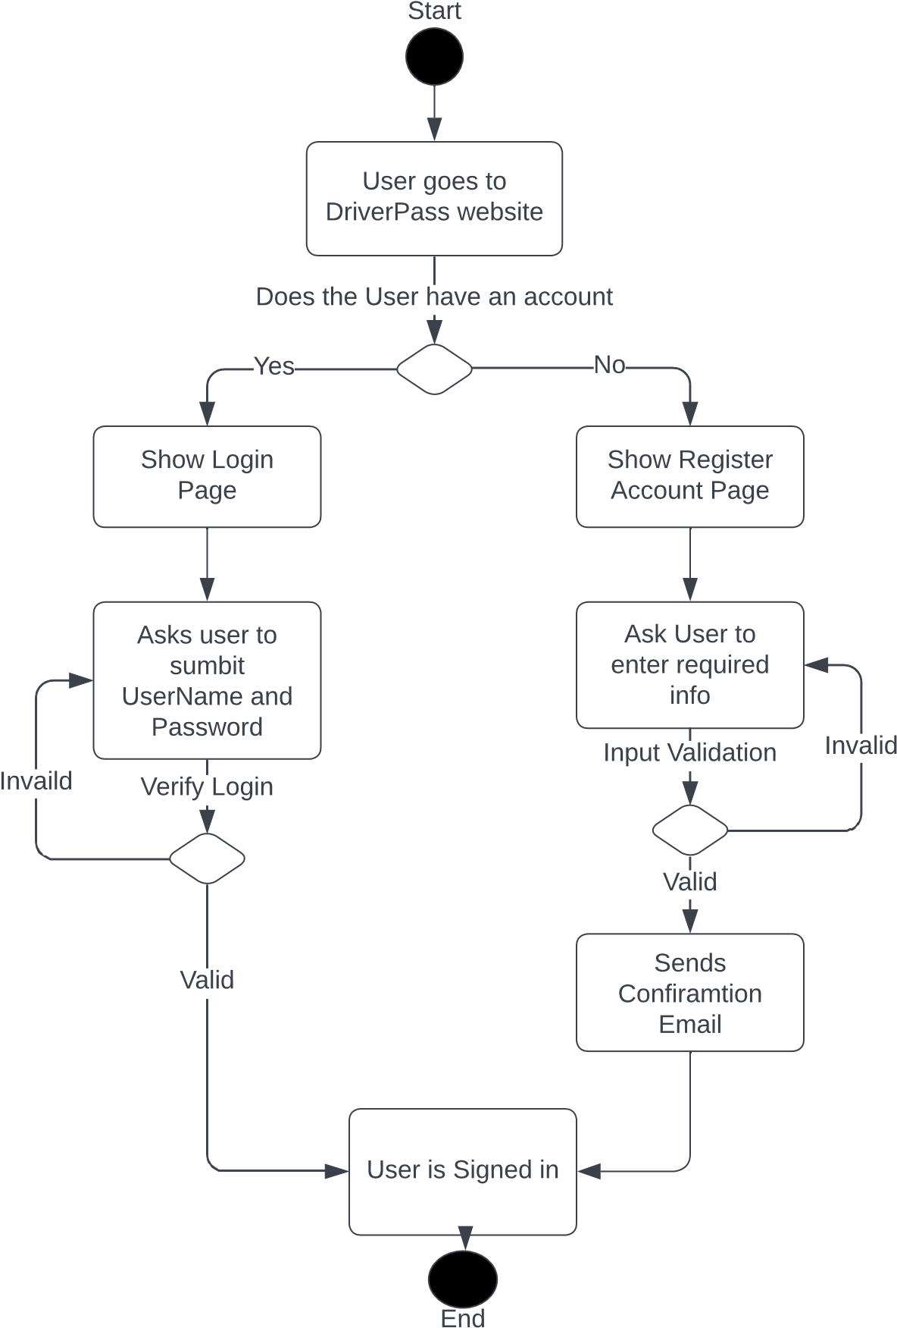
Activity Diagram
Notes:
I am going to delve into a specific function of DriverPass and that is the Activity of Logging In/ Registering an account. At the top of the graph is the start. This will show the users the first page of accessing DriverPass where it will as if they are looking to make a new account or log into an existing one. The decision made here will branch off to a different pages.
If the user chooses Make Account, the page they are sent to will then ask them to enter all the required information necessary. The system will then check if the information is valid. If no, it will instruct the user to re-enter the information. If yes, it will then send them a conformation email and log them into Driver Pass.
Now with the decision to Login at the beginning, the page they are sent to will as for the UserName and Password. Our system will them check the accuracy of that information. If something is wrong, it will send the user back to the login page. If everything is valid, it will log the user into their specific DriverPass account.

Slide 5
Security
Firewalls
Login Verification
Access Levels for Users
Notification of potential threats and changes
Notes:
DrivePass will we lined with firewalls to hopefully prevent any malware attacks or profile hacks. Every time a user comes to the website they will have to enter in a correct username and password to gain access. Since there might be a chance for error at login, we will provide a 5-time grace period where the user can try entering their information again. After the fifth time is passed with an incorrect login, the account will be locked, and a notification will be sent to the user and to Admin. The account will only become unlock if the user can verify their identity via email. Upon account registration, users will have to choose which type of user they are for DriverPass. (Owner, Admin, Customer and Driver). All roles other than Customers will require an access key to unlock that registrations. Having Access level for user will protect confidential information stored within the system. Lastly, all threats and changes will be notified immediately. This will include something as simple as changing a password or a username to make sure all the changes are authentic.

Slide 6
System Limitations
Time Frame
Budget
System Requirements
Notes:
We are only given 5 months to complete this projects. This means all questions and concerns need to be address as soon as possible and any challenges that arise need to be handled immediately. There was not much talk about budget for this project so we will need to schedule a time to discuss how much the company is looking to spend. The price can go up quick when it comes to maintaining a large cloud-based sever that needs to be able to scale later in the future to accommodate new users. Lastly, we are assuming that our clients will have access to the internet and a desktop and mobile device. We need to make sure we create a product that is accessible through website browsers that are common on those types of devices while still running a top performance speed.

